Slide 1
Professional Practice of Education Assistants
Professionalism

Slide 2
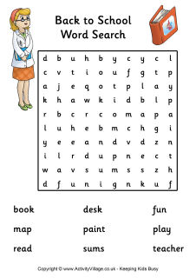

Activity: Word Search on Professionalism
Complete Word Search
Discuss:
  What are you noticing about the words in this word search?
  What does this tell us about the meaning of Professionalism?

Slide 3
Professionalism defined
“the conduct, aims, or qualities that characterize or mark a profession...”
      (Merriam-Webster dictionary)

Slide 4

Key points (from Mind Tools)
Competent: reliable, keep their promises, focus on finding solutions, have the tools they need, are prepared (plan, respond in a timely manner and are organized)

Slide 5

Key Points (from Mind Tools)
Knowledgeable: deep personal commitment to develop and improve their skills; stay up-to-date
Accountable: take responsibility for their thoughts, words and actions especially when they’ve made a mistake

Slide 6

Key Points (from MindTools)
Honest and work with integrity: keep their word; do the right thing even when it means taking a harder road; not afraid to say “I don’t know”; will ask for help; and willing to learn from others

Slide 7
Key points (from Mind Tools)
Respectful: treat others with dignity; are polite; exhibit a high degree of emotional intelligence by considering how others feel; don’t let a bad day influence how they interact with others

Slide 8
Key Points (from Mind Tools)
Self-regulate: stay calm and professional under pressure; manage behaviour and language
Look the part: dress appropriately for all situations the day will bring (may mean having extra clothes on-site); exude confidence

Slide 9

What is Ethical Behaviour?
“acting in ways consistent with the commonly held values of the organization (profession, education sector) and society”

